Slide 2



Problem Definition

Slide 3

Problem Definition
SYSTEM

Slide 4
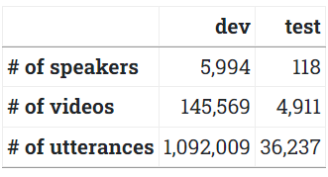
Dataset
VOXEL CELEB 2

Slide 5


Dataset
VOXEL CELEB 2

Slide 6
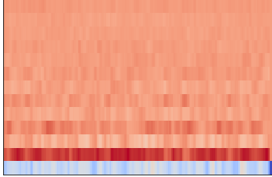
Preprocessing --- AuDIO
LINK

Slide 7
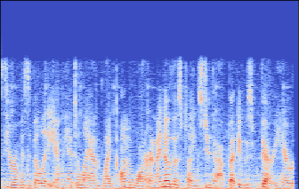
Preprocessing --- AuDIO
LINK

Slide 8

Preprocessing ---Video
LINK

Slide 9
PREPROCESSING – Age and gender Recognition
FEMALE 37

Slide 10
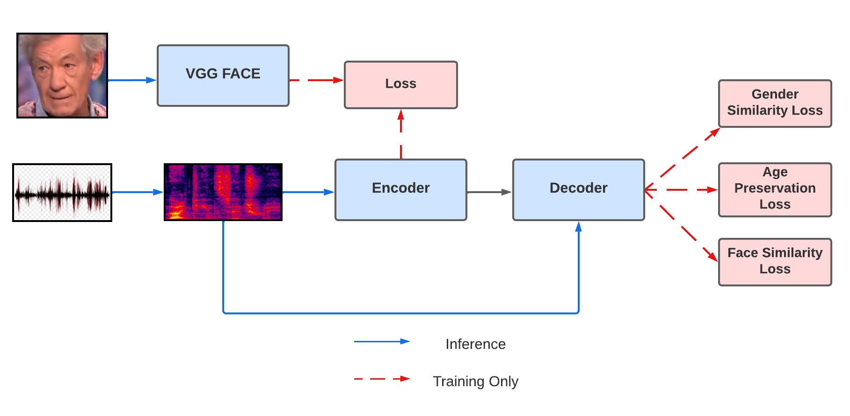
MODEL Architecture
[1,0.2,0.5,5..0,7]
[1,0.2,0.5,5..0,7]

Slide 11
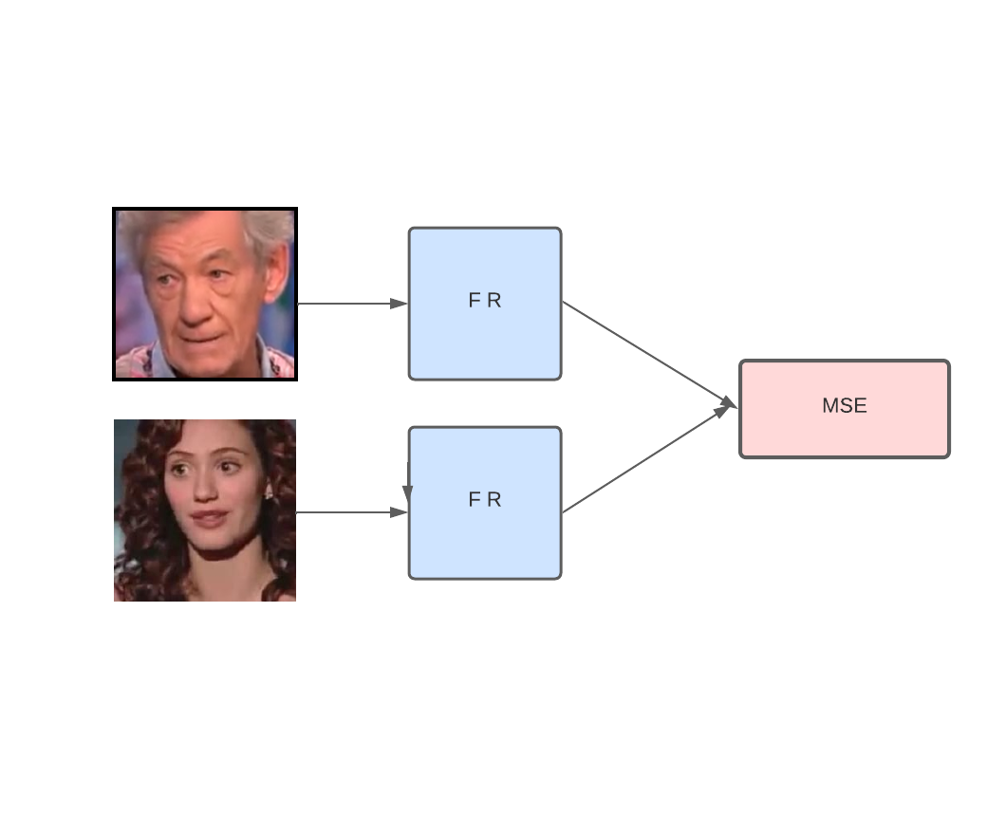
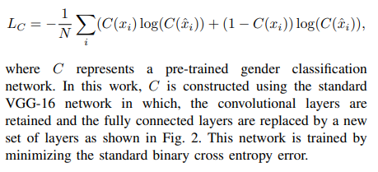
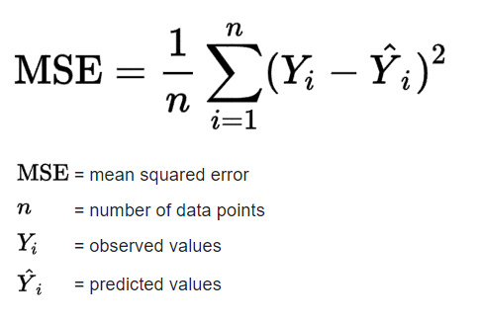
LOSSES:

